Slide 1

Mr. Hangman
Rysiek
Pawel

Slide 2
Objectives
Code optimization
Visualize the hangman when live is lost
Bug fixes
Implement hints when low on lives

Slide 3
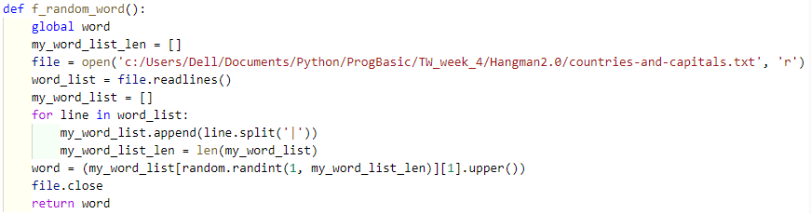

Simplifying functions
Simplifying functions
Simplifying functions
Before:
Now:

Slide 4
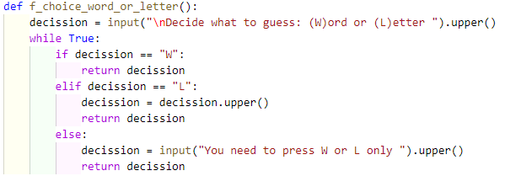
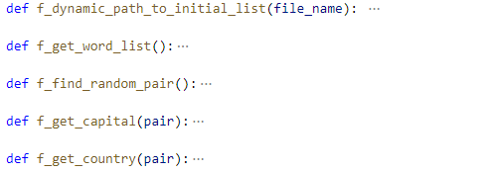
Simplifying functions
Simplifying functions
Simplifying functions
Before:
Now:

Slide 5
Lets Play

Slide 6
Challenges
Code optimization
Implementation of new functionalities
Finding bugs… and fixing them!

Slide 7
Next steps
High-score list
Adding time limit

Slide 8
What have we learned?
Difficult to Work on the code after a break
Communication is key
Control version is the way to go
Simple and clear functions -> code easy to read

Slide 9
Paweł Płusa
https://github.com/pawelplusa
Rysiek Górnowicz
https://github.com/boociann
THANK YOU

